Slide 1
Time Complexity

Slide 2

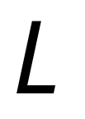
Consider a deterministic Turing Machine
which decides a language

Slide 3


For any string the computation of
terminates in a finite amount of transitions
Initial
state
Accept
or Reject

Slide 4
Decision Time = #transitions
Initial
state
Accept
or Reject

Slide 5

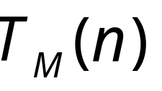
Consider now all strings of length
= maximum time required to decide
any string of length

Slide 6







TIME
STRING LENGTH
Max time to accept a string of length

Slide 7
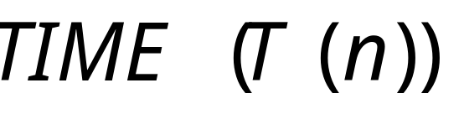
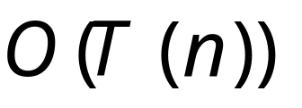



Time Complexity Class:
All Languages decidable by a deterministic Turing Machine
in time

Slide 8
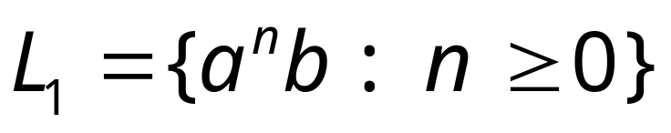
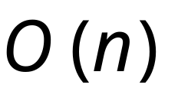
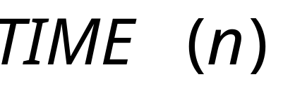
Example:
This can be decided in time

Slide 9
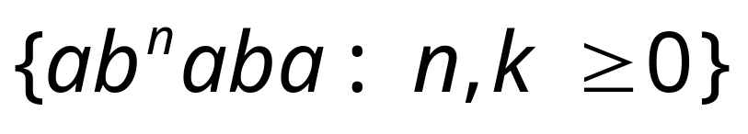
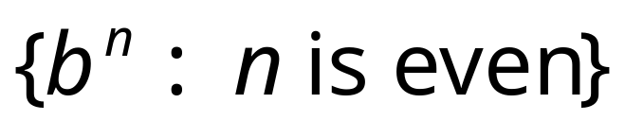
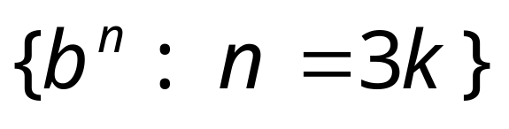
Other example problems in the same class

Slide 10
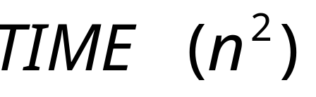
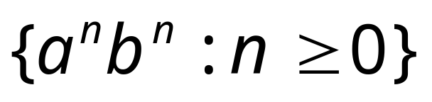
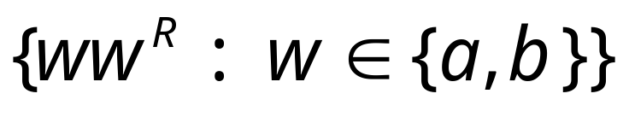
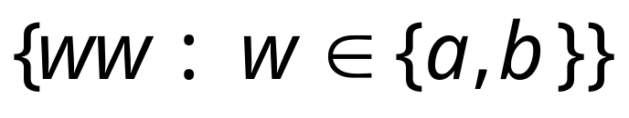
Examples in class:

Slide 11
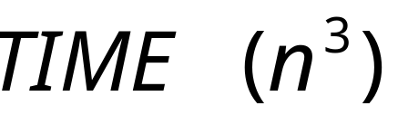
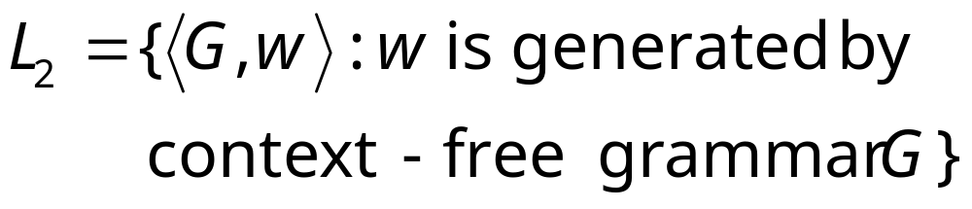
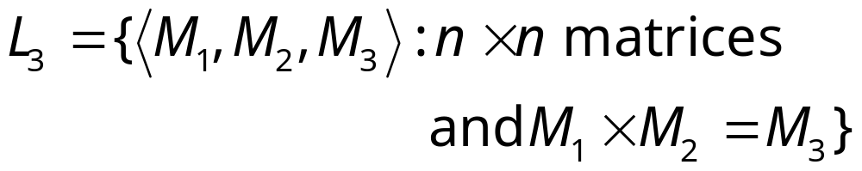
Examples in class:
CYK algorithm
Matrix multiplication

Slide 12
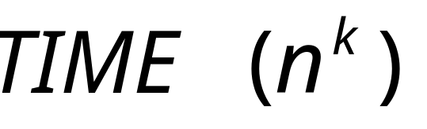
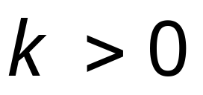
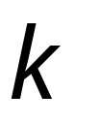
Polynomial time algorithms:
constant
Represents tractable algorithms:
for small we can decide
the result fast

Slide 13
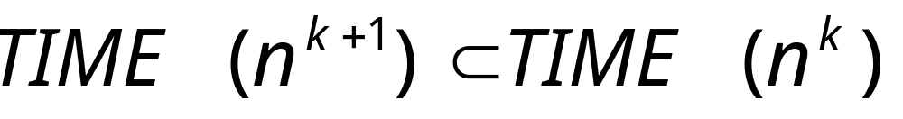
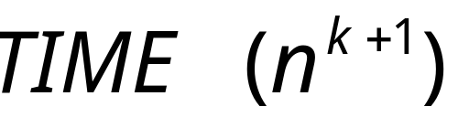

It can be shown:

Slide 14
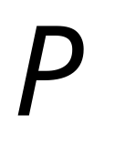
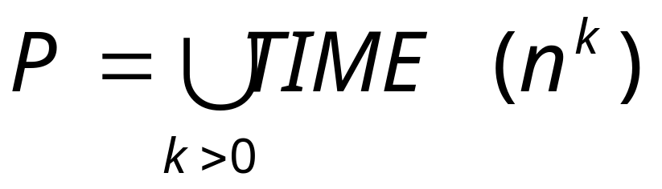
The Time Complexity Class
Represents:
polynomial time algorithms
“tractable” problems

Slide 15

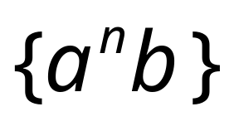
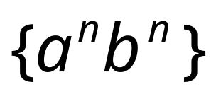

Class
CYK-algorithm
Matrix multiplication

Slide 16
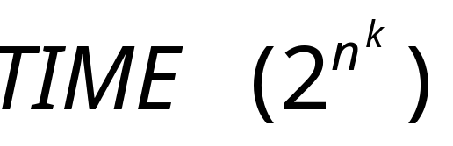
Exponential time algorithms:
Represent intractable algorithms:
Some problem instances
may take centuries to solve

Slide 17
Example: the Hamiltonian Path Problem
s
t
Question: is there a Hamiltonian path
from s to t?

Slide 18
s
t
YES!

Slide 19
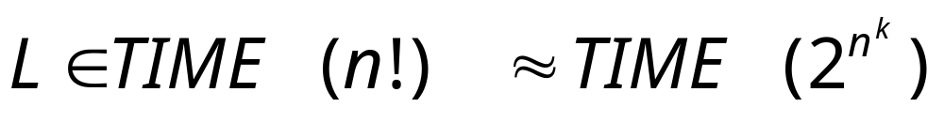
A solution: search exhaustively all paths
L = {<G,s,t>: there is a Hamiltonian path
in G from s to t}
Exponential time
Intractable problem

Slide 20
The clique problem
Does there exist a clique of size 5?

Slide 21
The clique problem
Does there exist a clique of size 5?

Slide 22
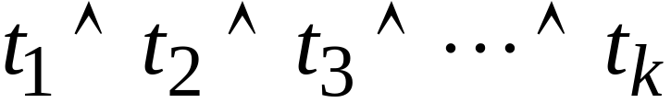
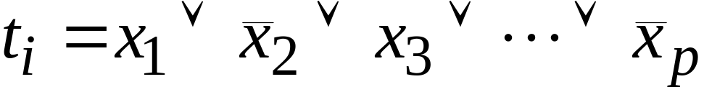
Example: The Satisfiability Problem
Boolean expressions in
Conjunctive Normal Form:
clauses
Variables
Question: is the expression satisfiable?

Slide 23
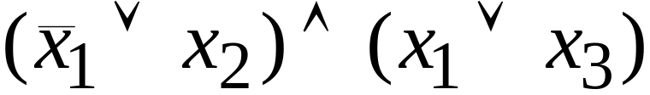
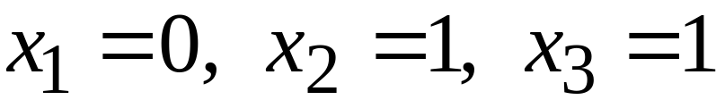
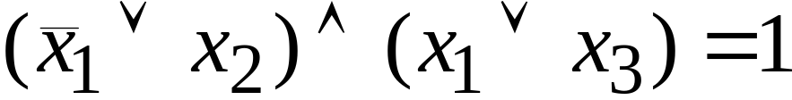
Example:
Satisfiable:

Slide 24
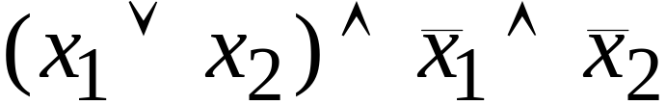
Example:
Not satisfiable

Slide 25
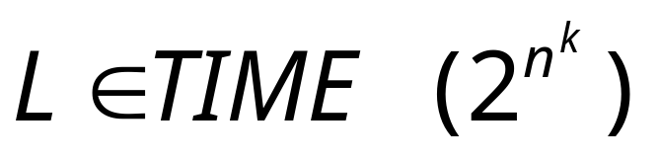
exponential
Algorithm:
search exhaustively all the possible
binary values of the variables

Slide 26
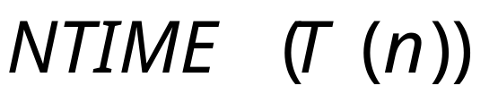

Non-Determinism
Language class:
A Non-Deterministic Turing Machine
decides each string of length
in time

Slide 27
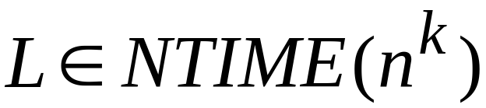
Non-Deterministic Polynomial time algorithms:

Slide 28

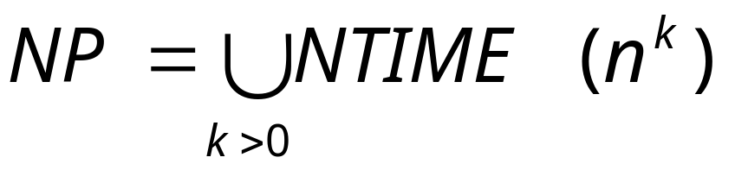
The class
Non-Deterministic Polynomial time

Slide 29
Example:
The satisfiability problem
Non-Deterministic algorithm:
Guess an assignment of the variables
Check if this is a satisfying assignment

Slide 30
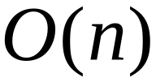
Time for variables:
Guess an assignment of the variables
Check if this is a satisfying assignment
Total time:

Slide 31


The satisfiability problem is an - Problem

Slide 32

Observation:
Deterministic
Polynomial
Non-Deterministic
Polynomial

Slide 33
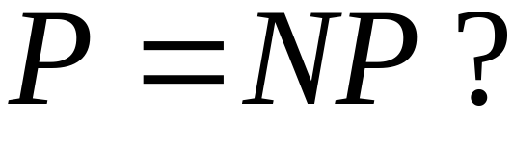
Open Problem:
WE DO NOT KNOW THE ANSWER

Slide 34
Open Problem:
Example: Does the Satisfiability problem
have a polynomial time
deterministic algorithm?
WE DO NOT KNOW THE ANSWER

